Slide 1


Arcade Makecode: Super Dungeon Explorer

Slide 2
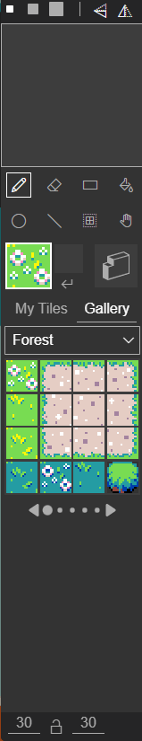
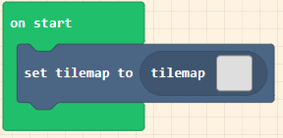
Create a Dungeon
Setup the first level of your dungeon
Find the SET TILEMAP TO from SCENE
Click on the TILEMAP
Increase the size to 30 x 30
Fill the level with grass
Draw 4 rooms with the square tool
Link them with a line 3 blocks wide
Draws WALLS around the areas that your character should not be able to go

Slide 3
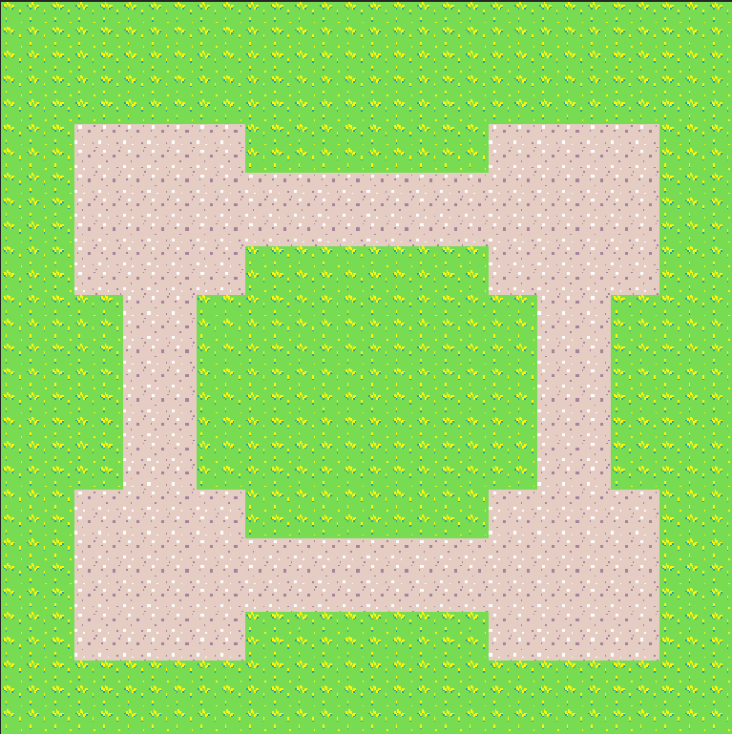
Dungeon Example: Basic

Slide 4
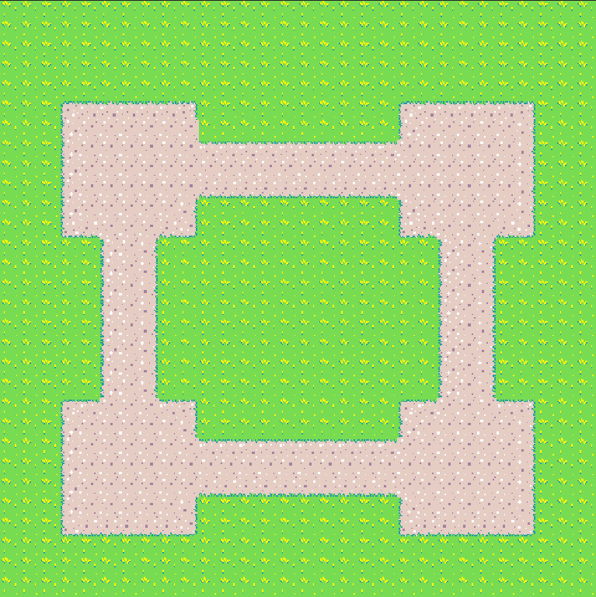
Dungeon Example: Advanced

Slide 5
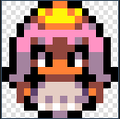
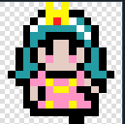
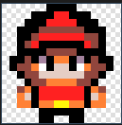

Create a Player Character
Find SET MYSPRITE TO from SPRITE
Name your player by selecting MYSPRITE and RENAME
Select a character from the GALLERY
For now choose one of these three only. You can edit them later

Slide 6
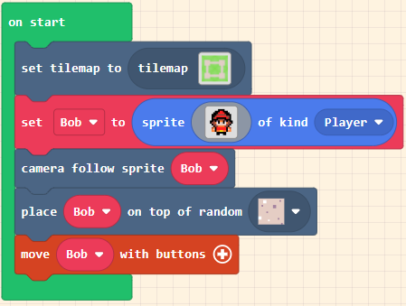
Game SETUP
Add in the 3 new blocks
One will tell the camera to follow the player
One will spawn the player on a random floor space
One will move the player with the buttons

Slide 7
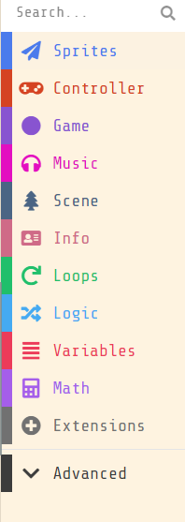
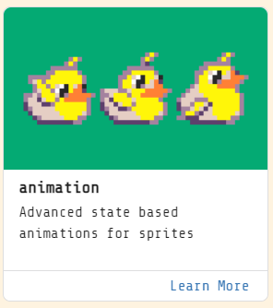
Animating the Player
Find extensions and add in the animation library.
It will be added under ADVANCED

Slide 8
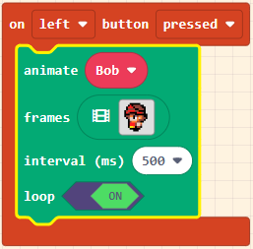
Animating the Player
Under controller find the ON BUTTON and change it to LEFT
Add in an Animate block
Set it to your player
Select the left walking animation
Click on loop
Do this for UP/RIGHT/DOWN

Slide 9
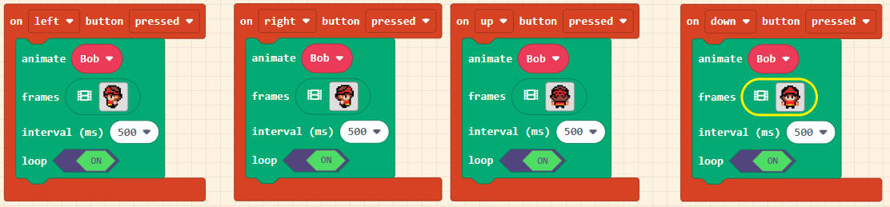
Animating the Player Example

Slide 10
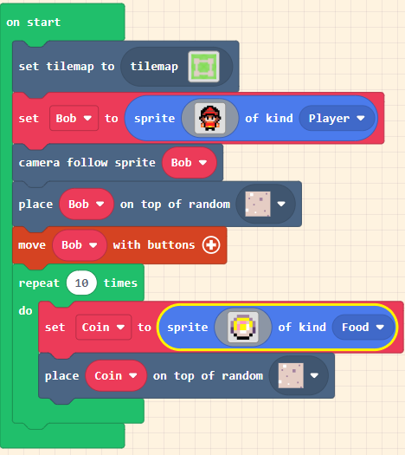
Spawning Coins
This will spawn 10 coins at random points in the level
Make sure to set the coin as FOOD

Slide 11
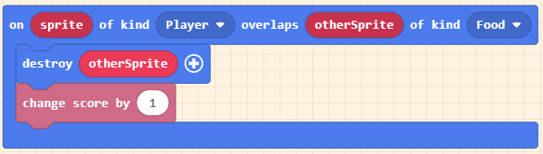
Collecting the Coins
Drag OTHERSPRITE into the destroy block
Change the score by 1 for each coin

Slide 12
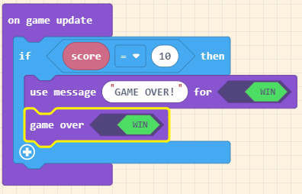
Winning The Game
Once the score reaches 10 the game will end.

Slide 13
LEVEL 2
We are going to create a more advanced level 2
It will have enemies and a new map
First we need to edit our existing code

Slide 14
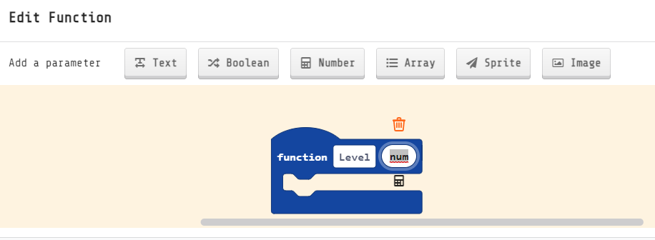
Functions
Functions allow you to run the same piece of code as often as you want.
We are going to create a level select function.
Under ADVANCED create a new FUNCTION called LEVEL
Add a number parameter
A parameter is an input for the function
This one will tell us what level to go to

Slide 15
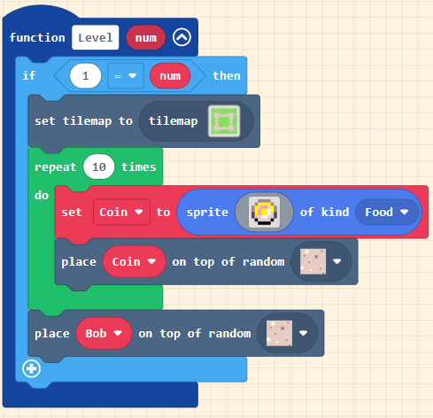
Level 2 SETUP
We need to move all of the code that is to do with the level into an IF STATEMENT in our LEVEL function
The IF STATEMENT will load up level 1 if num is set to 1
Everything else is the same

Slide 16
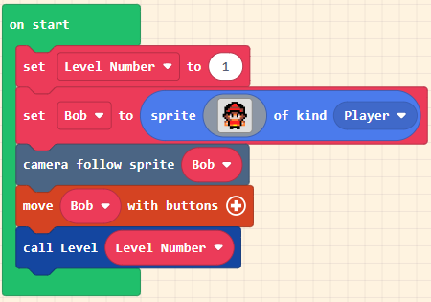
Level 2 SETUP 2
The start now needs a new variable called LEVEL NUMBER which is created under VARIABLES
Set this to 1
Under FUNCTIONS in ADVANCED call our LEVEL FUNCTION and use our new VARIABLE to set the level

Slide 17
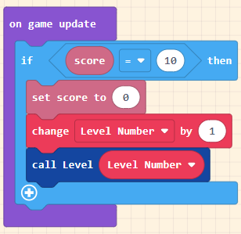
Level 2 SETUP 3
This small change will let you add as many levels as you want
Every time you reach 10 points the next level will load

Slide 18
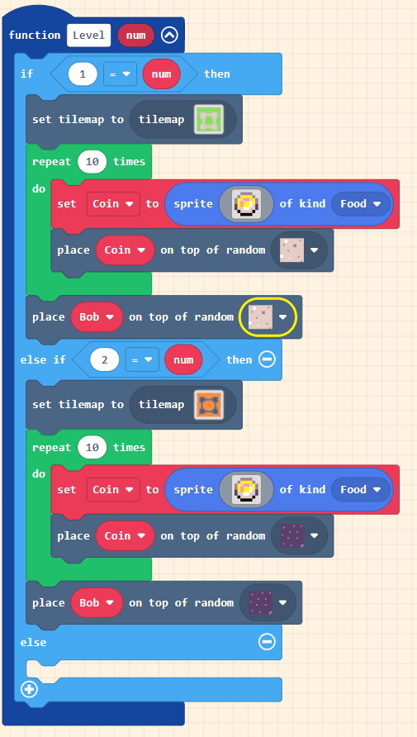
Creating Level 2
Click on the plus at the bottom of the if statement twice
Duplicate all of your code for Level 1 and put it into the elseif gap

Slide 19
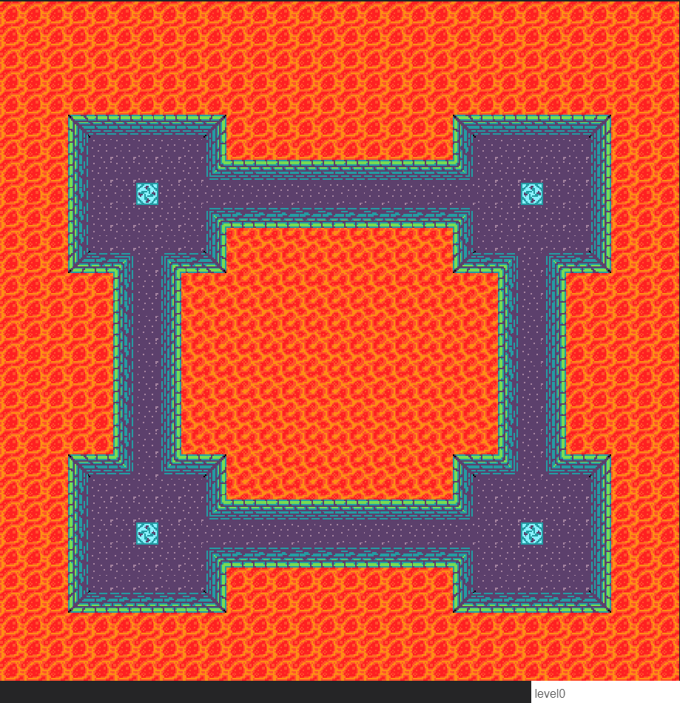
Creating Level 2
Click on the tilemap
Create 4 spawn points
Make sure that the name of the map is DIFFERENT to Level 1

Slide 20
Creating Level 2
Change the placement tile to the new floor tile

Slide 21
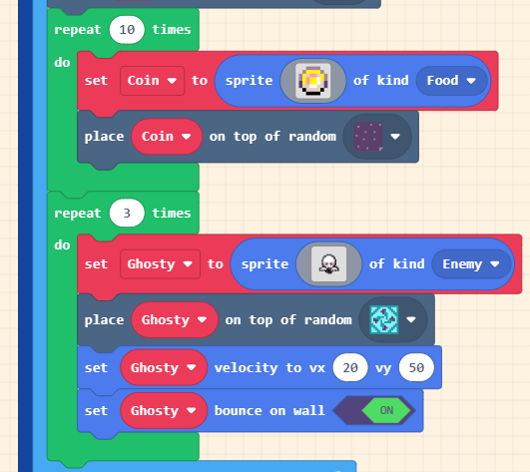
Adding BASIC ENEMIES
Using the same idea as the adding the coins add 3 ghosts to spawn on your spawn points
This will go under the coin spawn in Level 2
Make sure to set the KIND to ENEMY
You can change the velocity amounts to values that work best for you

Slide 22
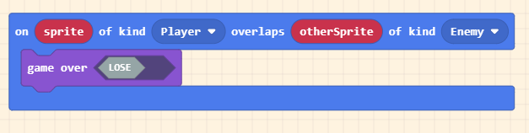
Enemies ATTACK!
In the same way that the player interacts with FOOD we are going to interact with ENEMIES
We will make our game tough and have it as an instant death if you are hit!

Slide 23
LEVEL 3
We are going to create a tough boss level
We are going to create a BOSS
And a way to fight back!

Slide 24
Level 3 SETUP
Complete the setup in the same way as you created level 2.
As this is the final level you do not need to spawn any coins
You still need to spawn basic enemies though
Your map needs to have the following special tiles:
4 x Enemy spawn points
1 x Boss spawn point
2 x Health spawn points
2 x Ammo spawn points

Slide 25
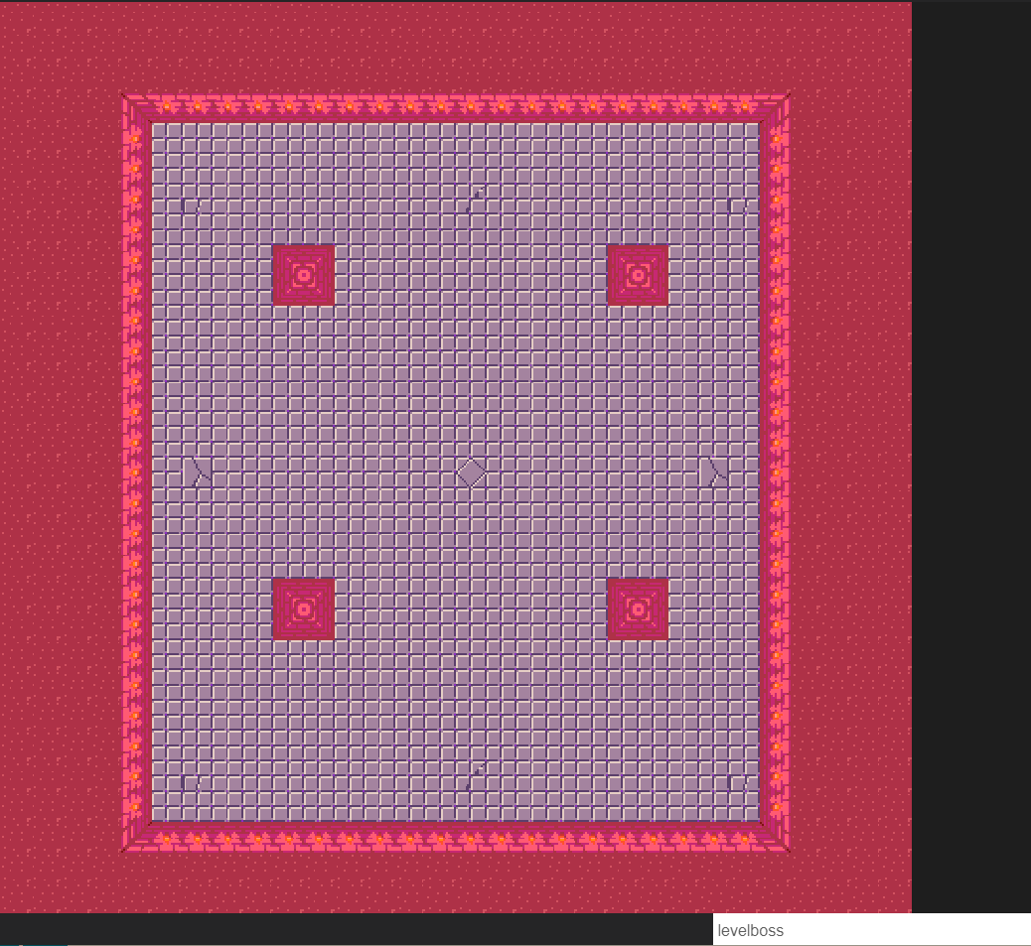
Level 3 Setup EXAMPLE

Slide 26
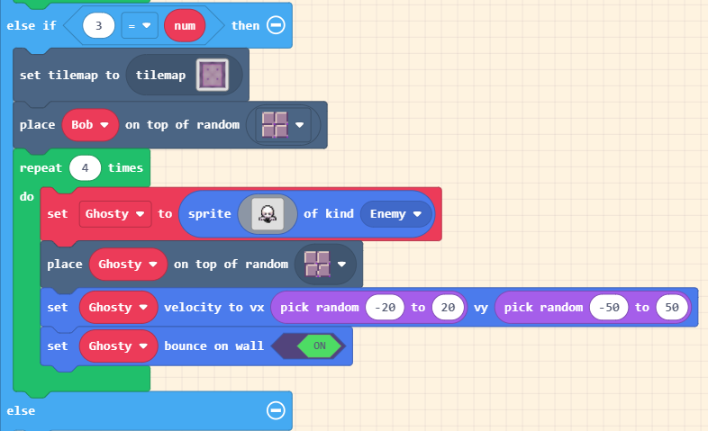
Level 3 BASIC ENEMY
This will be the same as Level 2 but with a new spawn tile
The enemies can now move in different directions

Slide 27
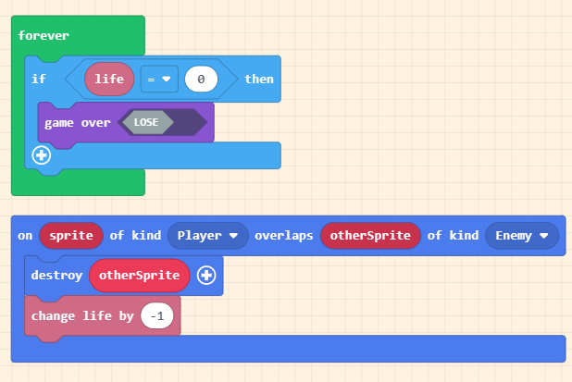
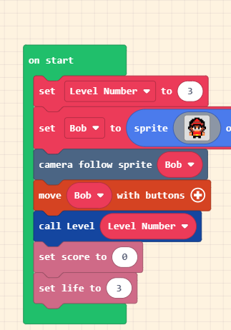
Level 3 HEALTH
We are going to give the player a hand and give them 3 health
Set 3 to health at the start
Change the ENEMY OVERLAP to take 1 health away
If Player Health ever reaches 0 it’s game over

Slide 28
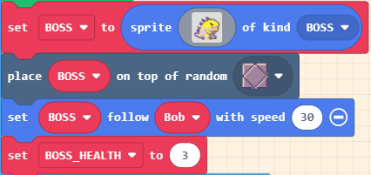
Level 3 BOSS
Create a new sprite
Rename as BOSS
Use the KaijuMomWalk0
Spawn it on the Boss Spawn
Set the kind to BOSS
Make the BOSS follow the player
Create a variable called BOSS_HEALTH
Set BOSS_HEALTH to 3

Slide 29
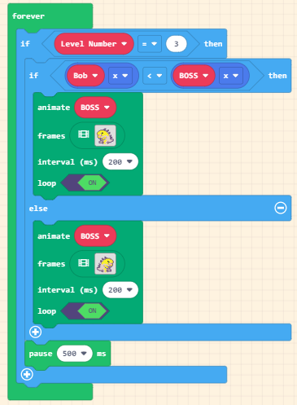
Level 3 BOSS Movement
This will make the BOSS face the player and animate the walking
You will need to make sure that this only runs at level 3 with an IF STATEMENT

Slide 30
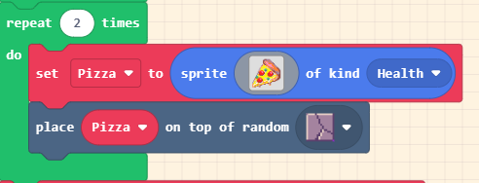
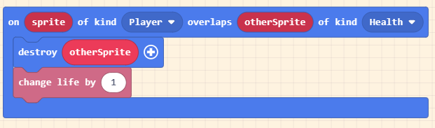
Level 3 PLAYER HEALTH
In order to get some health back we will do the reverse of the enemy overlap
Make sure that you set the Pizza to a kind called HEALTH
Make it spawn on the correct tile

Slide 31
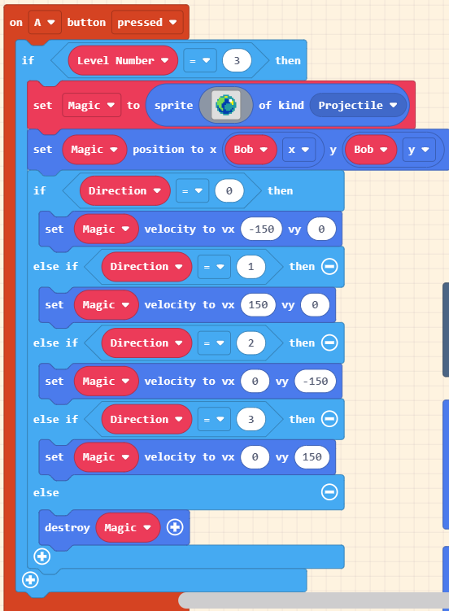
Level 3 PLAYER ATTACK
We will only give the player the ability to attack at level 3 using an IF STATEMENT
When A is pressed a magic ball will travel in the direction you are moving
Make the magic ball appear at the players location
Change the VX & VY for each direction
Left is VX -150
Right is VX 150
Up is VY -150
Down is VY 150
Set the else to destroy the magic ball

Slide 32
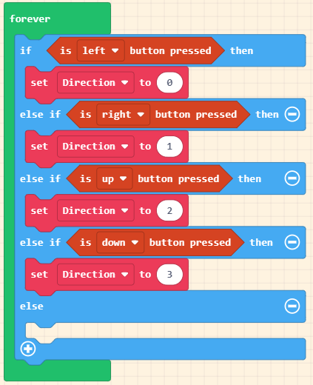
Level 3 PLAYER ATTACK

Slide 33
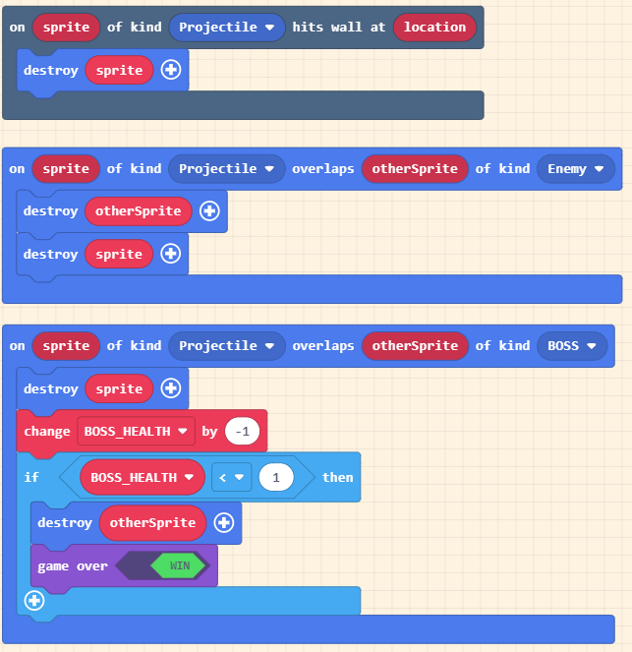
Level 3 PLAYER ATTACK EFFECT
3 effects need to be programmed
The magic ball will need to be destroyed when it hits a wall
The magic ball will need to be destroyed when it hits an enemy
The magic ball will reduce the BOSS_HEALTH by 1
If the BOSS_HEALTH reaches 0 then you win the game.

Slide 34
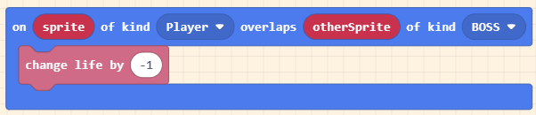
Level 3 BOSS ATTACK BASIC
We will setup a basic attack for the BOSS in the same way as GHOSTY

Slide 35

Level 3 BOSS ATTACK ADVANCED
The boss is going to fire FIRE in 8 directions
We will use a FOR LOOP for this
It will have an index that will start at 0 and increase up to 7
Depending on what the index will be will determine what direction the FIRE will go
VX = 0 VY = -150
VX = 150 VY = -150
VX = -150 VY = -150
VX = -150 VY = 0
VX = 150 VY = 0
VX = -150 VY = 150
VX = 150 VY = 150
VX = 0 VY = 150

Slide 36
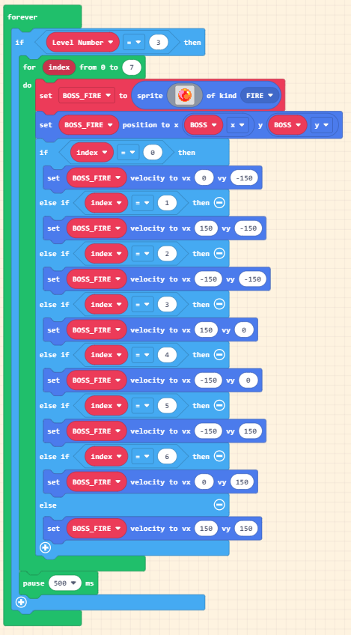
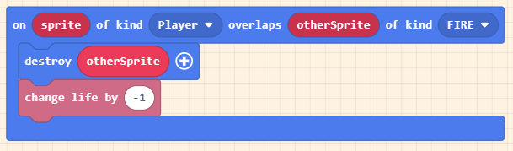
Level 3 BOSS ATTACK ADVANCED
Remember to set the start position to the same as the BOSS and add the correct overlap

Slide 37
Level 3 EXTENSION
Create a new sprite that will spawn on the AMMO SPAWN
Players can only fire if they have AMMO
AMMO should respawn if the players AMMO reaches 0
Health should respawn
Ghosty should respawn
Add a bonus level!

